Slide 1
Hackathon 2024: RED BULLS

Slide 2

Team Name and Members
Ignatius Nobel Chittilappilly
S8,dept of CSE
Interested in web development and programming.
Done projects on Pronunciation Mistake Detection,Personalised Desktop Assistant for Paralyzed
Team Lead

Slide 3

Team Name and Members
Haritha Tony
S8,dept of CSE
Interested in web development and programming
Done projects on Surgical Instrument Detection and Counting System,Pothole Detection and Alarming System
Data/ML Engineer

Slide 4

Team Name and Members
H Athulkrishnan
S6,dept of CSE
Interested in web development , generative AI and programming.
Done project on Imagery-Storyteller.
Software Engineer

Slide 5

Team Name and Members
Hanna Jose
S8,dept of CSE
Interested in web development and programming
Done projects on Surgical Instrument Detection and Counting System,Pothole Detection and Alarming System
Presentation /Documentation

Slide 6

Team Name and Members
Aarya V S
S6,dept of CSE
Interested in web development and programming
Done project on fashion recommendation system using deep learning.
Presentation/Documentation

Slide 7
LLM Problem Statement: Why
Lack of appointing HR staffs in medium sized enterprises always raises the question of authenticity as there exists no other communication channels for the company staffs to enquire about their queries or others to know about the details on new recruitments.
To get rid of this prevailing challenge,we have developed a smart HR- gpt that can automate the tasks done by an HR personnel .
Our HR-gpt is capable of doing tasks such as responding to employee queries on leave requests,salary incentives and other allowances.It also does the tasks of employee onboarding such as verifying CVs,shortlisting candidates and scheduling their interviews.

Slide 8

LLM Business Problem: What
The lack of HR staff in medium sized enterprises presents significant business challenges like:
Operational Inefficiencies
Recruitment Challenges
Communication Barriers
Compliance Risks
Employee Retention

Slide 9
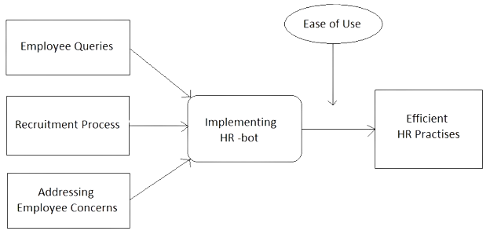
LLM Business Problem: What
These can be addressed by implementing our smart HR-bot to automate HR tasks and improve overall HR management within the organization.

Slide 10
Solution Overview: How
For addressing the identified challenge we have,
Conducted a thorough assessment of the company’s HR needs and pain points.
Designed and developed an HR-bot tailored to the company’s requirements
For developing our smart solution ,we have used the following resources:
Langchain,tkinter,PIL,PyPDF2,re,pytesseract,smtplib,streamlit,
pinecone,openai

Slide 11
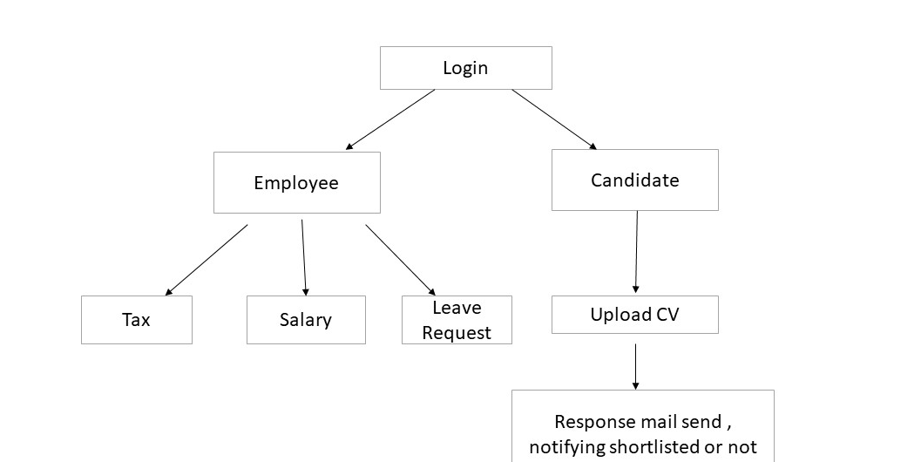
Solution Overview: How
Here is how our solution process like

Slide 12
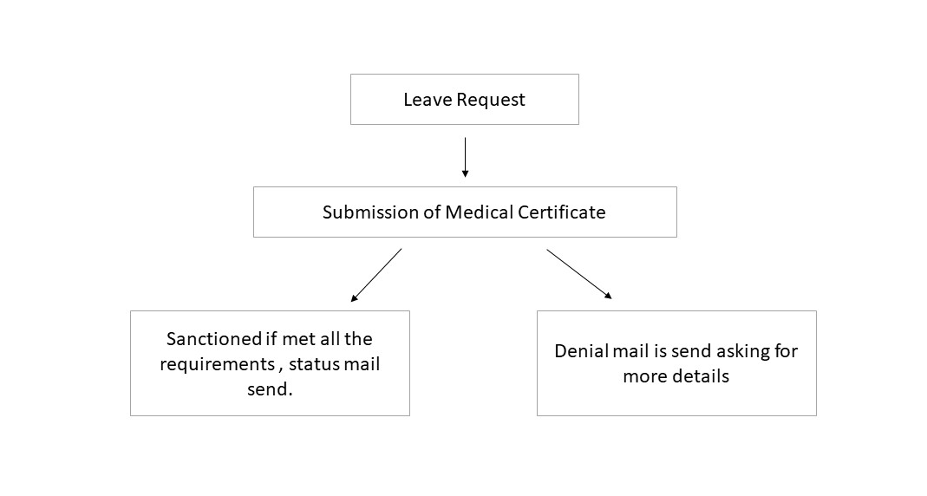
Solution Overview:How
Here is how the HR-bot responds to a leave request

Slide 13

Economic Logic
The idea of developing a smart HR-bot who can take up the role of a human HR personnel can provide various economic benefits for a medium sized enterprise.
Cost Savings
Scalability
Focus on Core Activities
Reduced Errors
Efficiency Gains

Slide 14
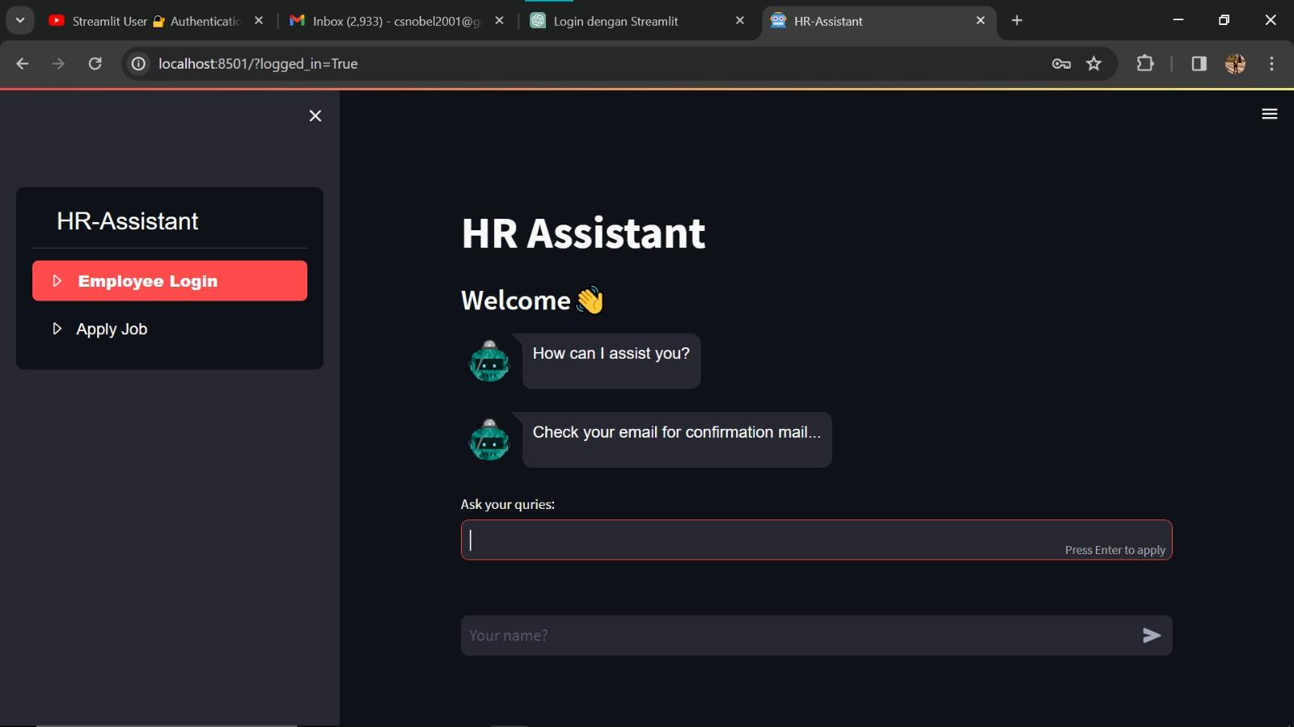
Project Demo
Here is the demonstration of our HR-Bot:

Slide 15
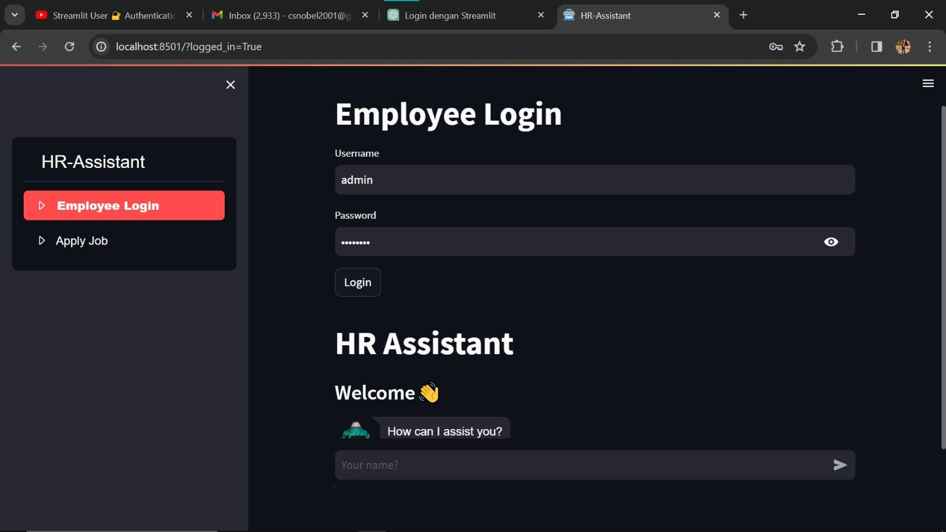
Project Demo
This shows how an employee can access the bot

Slide 16
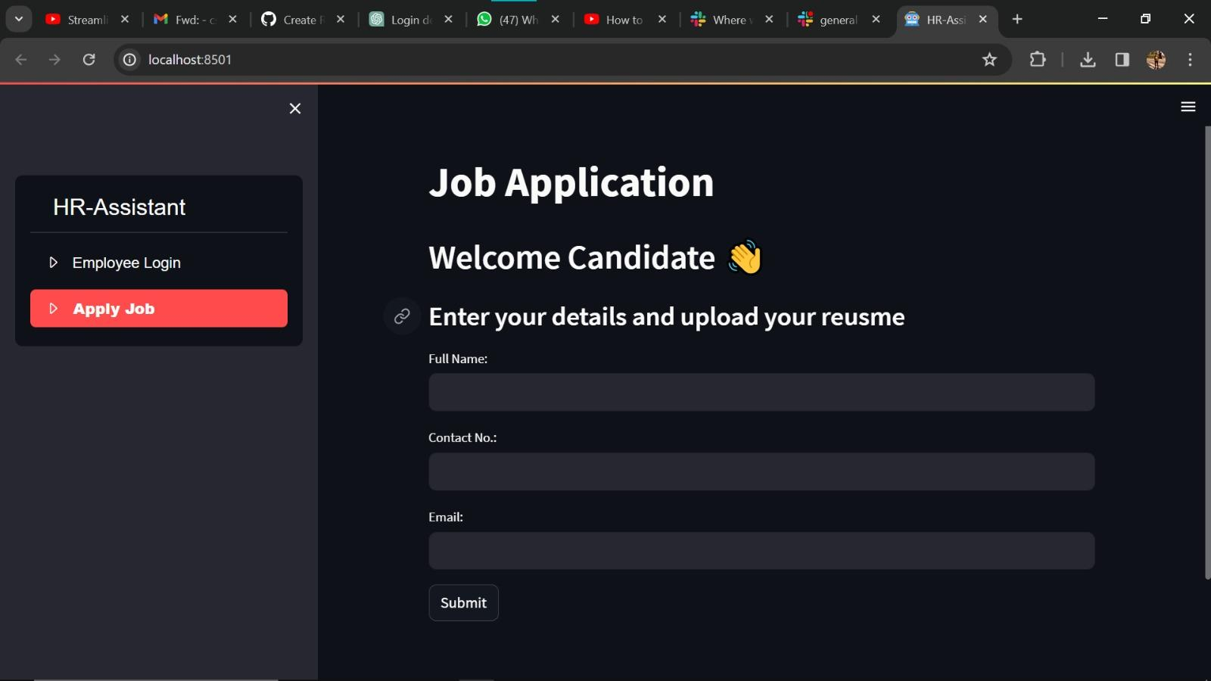
Project Demo

Slide 17
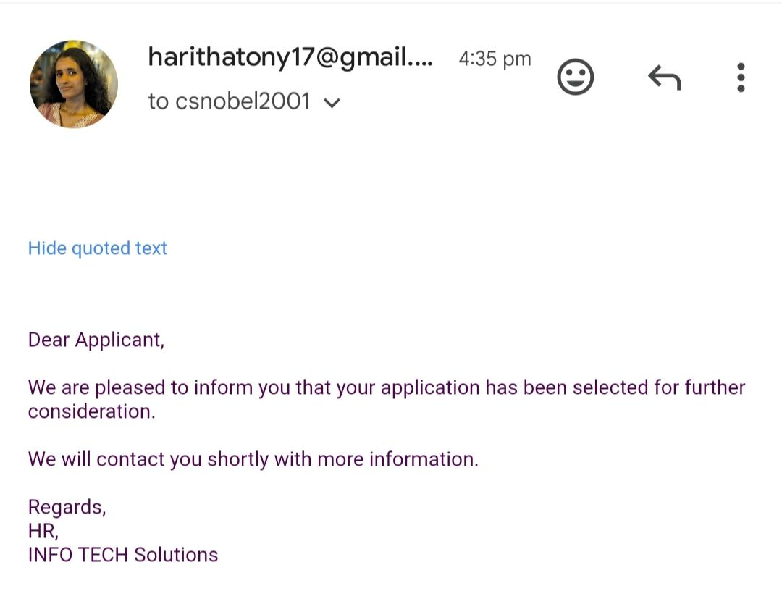
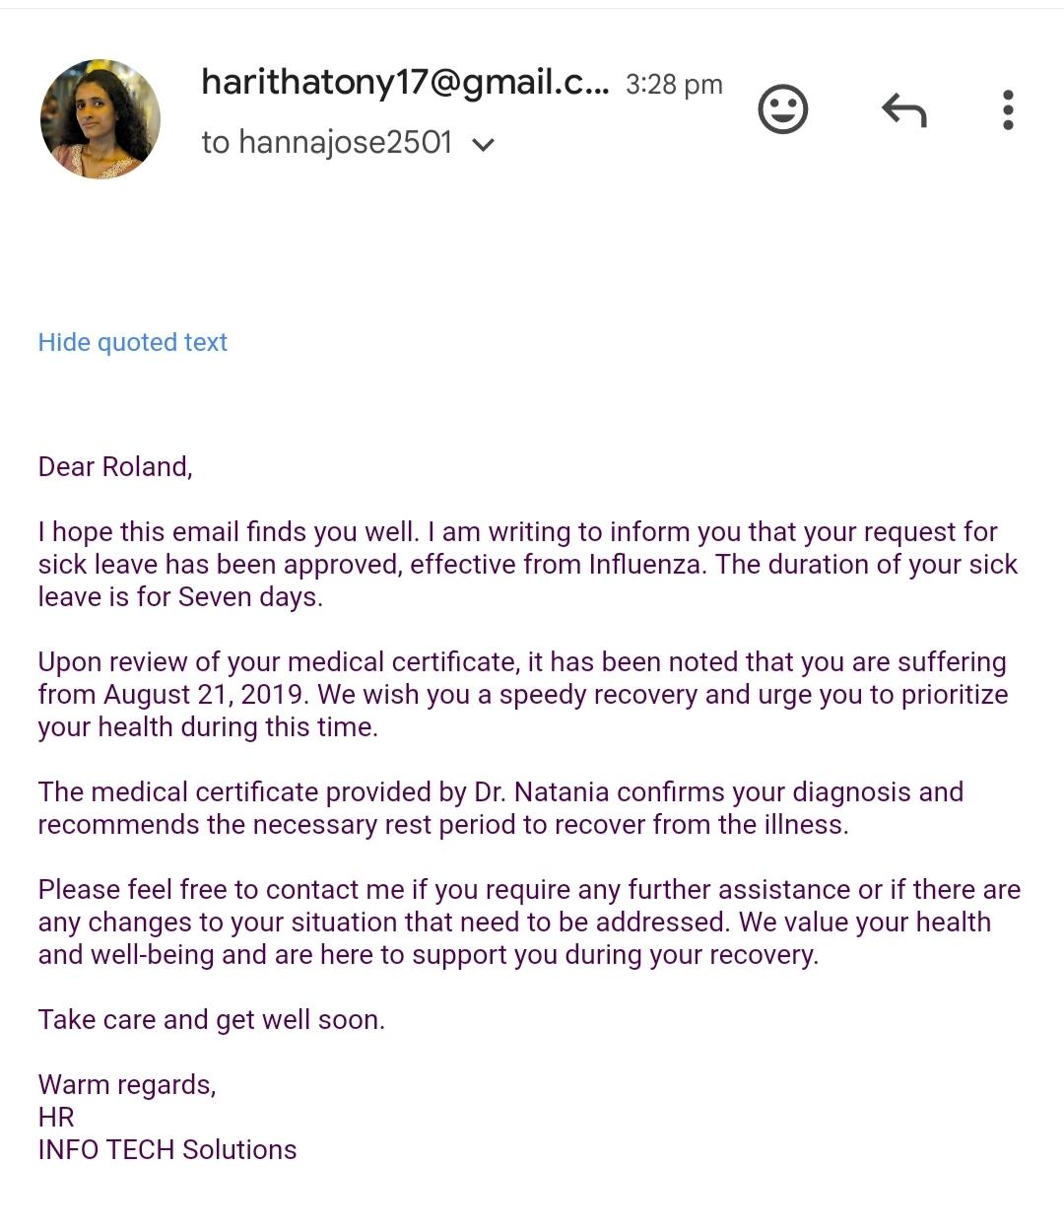
Project Demo
Response Mails

